Slide 1
Class of 2022 Postsecondary Planning
Counseling Office Staff:
Last Names A – K: Jessica Diedrich
Last Names L – Z: Erica Hughes
Graduation Coach: Cindy Herford

Slide 2
Graduation Requirements
Students taking B part online of any class with an EOC must finish by early April to take your EOC!

Slide 3
Junior year is usually the toughest...
Pay attention now to your
study time & grades to enjoy
a smoother and more fun senior year!

Slide 4
HOPE/Zell Miller Scholarship
Calculated differently than your HS GPA in Infinite Campus
Unweighted GPA of all your English, math, social studies, science, and foreign language courses
Must have a 3.0+ HOPE GPA at end of senior year to qualify
Zell Miller: have a 3.7+ HOPE GPA at end of senior year AND 1200+ SAT or 26+ ACT in single test administration to qualify
Check your status at www.GAFutures.org

Slide 5
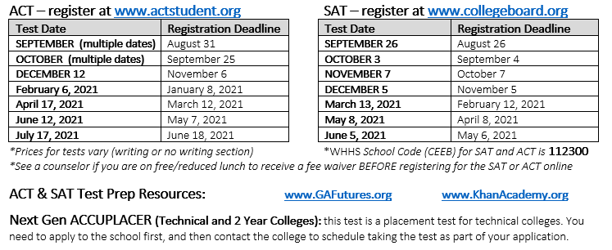
College Testing
You must send your test scores to college(s) you are applying to – login your SAT or ACT student accounts to request/send official scores.

Slide 6
SAT and ACT Helpful Tips
Fill out your lunch form this year AND next year
Those on F/R lunch qualify for 2 FREE SATs and 2 FREE ACT tests + several college application fee waivers in your SAT student account online
Free Preparation for SAT & ACT
www.GAFutures.org
www.khanacademy.org/sat

Slide 7
CollegeBoard Opportunity Scholarships
The Scholarships | Actions You Take | Timeframe
$500: Build your college list | Build a college list on BigFuture | Junior Year: Dec 2019 – June 2020
$1000: Practice for the SAT | Use official SAT practice on Khan Academy | Junior & Senior Year: Dec 2019 – Oct 2020
$2000: Improve your score | Improve your SAT score by 100+ points | Junior & Senior Year: April 2020 – Jan 2021
$500: Strengthen your college list | Strengthen your college list on BigFuture | Senior Year: July 2020 – October 2020
$1000: Complete the FAFSA | Fill out your FAFSA to apply for aid | Senior Year: October 2020 – February 2021
$1000: Apply to Colleges | Apply to schools you want to attend | Senior Year: October 2020 – February 2021
$40,000: Complete your Journey | Complete all six scholarship actions above to enter! | Final drawing: March 2021

Slide 8
Interested in College Athletics?
NCAA Division I – III schools
You must register at www.eligibilitycenter.org
NAIA – smaller schools
You must register at http://www.playnaia.org
You must qualify academically – you must also login your SAT/ACT accounts to request your test scores to be sent to these eligibility centers
See counselor to request your HS transcript to be sent!

Slide 9
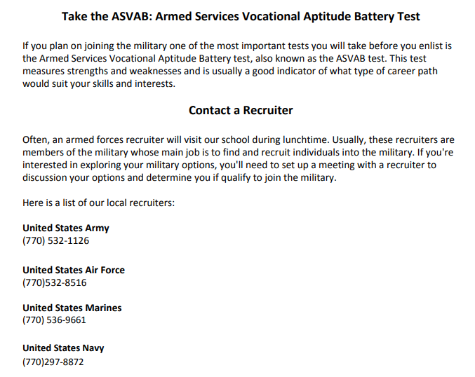
Interested in a military career?

Slide 10
Follow us!
@WHHSGuidance – Instagram & Twitter
WHHS Counseling Canvas & Website

